Slide 1

Stronger After the Fall: Compensatory Fricativization of /b d g/ after Coda /s/ Weakening
Santiago Arróniz
University of Nevada, Reno
LSRL 2025 - PUCMM

Slide 2
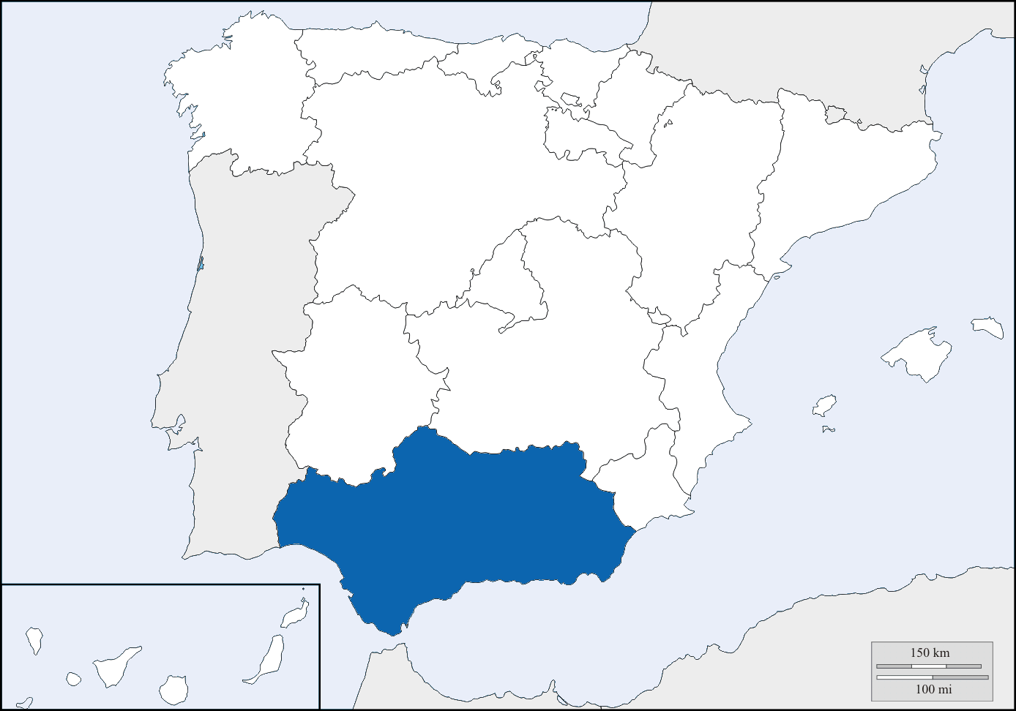
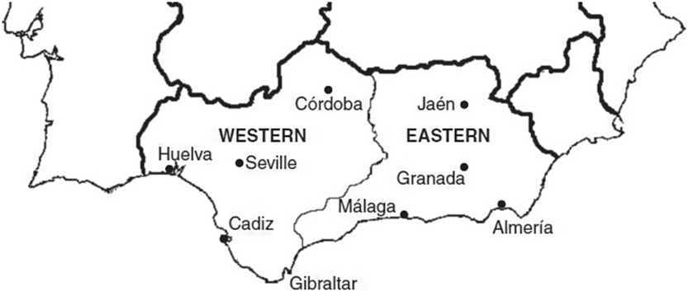
Why Western Andalusian Spanish?
WAS as a “testing ground” for lenition & compensation
Two hallmark processes:
/s/ weakening (aspiration, elision, etc.)
spirantization of /b d g/ (approximants vs. fricatives)

Slide 3
The Lenition of /s/ in Spanish
The reduction of /s/ in coda position has been widely reported to occur in many different varieties of Spanish
Depending on the dialect, this lenition process has been described to result in:
an aspirated variant (Bybee, 2000; Hualde, 2005; Lipski, 1994)
a voiced variant (Willis et al., 2015)
a glottal occlusion (Luna, 2010; Valentín-Márquez, 2006; Núñez-Méndez, 2022)

Slide 4
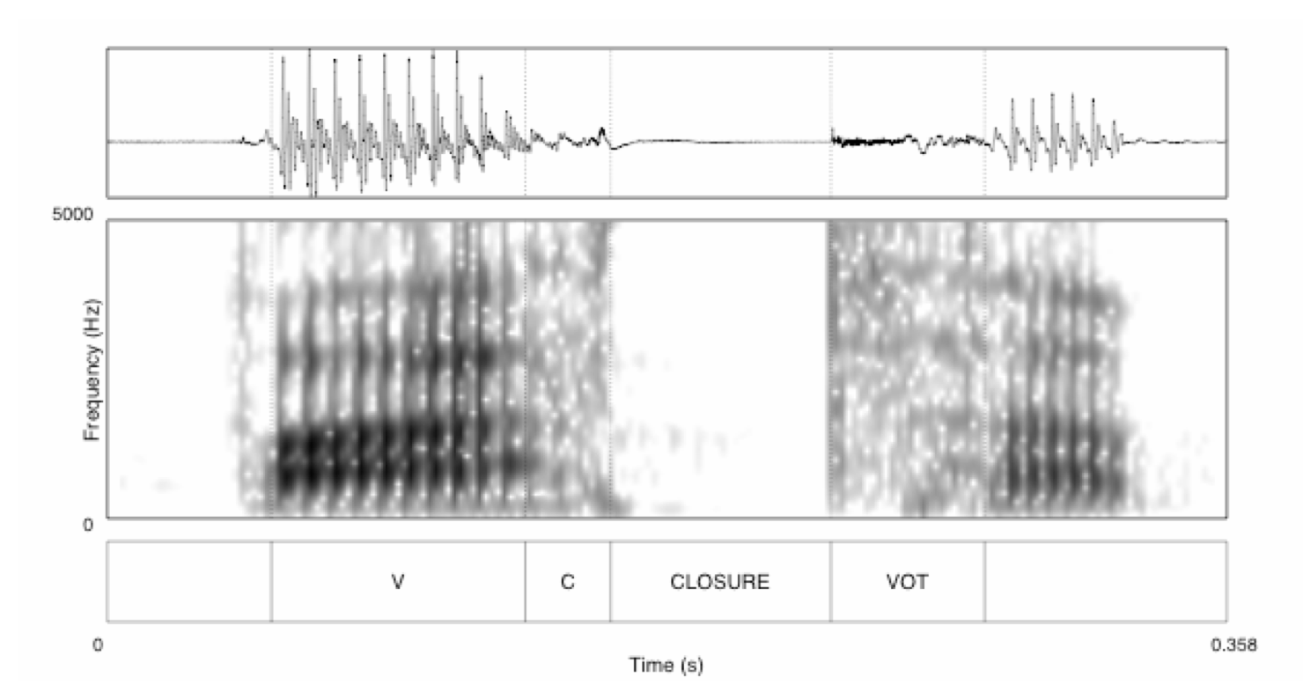
The Lenition of /s/ & Phonological Processes
Previous work on /s/ + /p t k/ clusters found an increased VOT on the voiceless stop in WAS (Torreira, 2006, 2007; Ruch and Harrington, 2014; Ruch and Peters, 2016; Martínez Celdrán and Fernández Planas, 2007; del Saz, 2015; Gilbert, 2022; inter alia)
Post-aspiration, as well as affrication of /s/ + /p t k/ clusters have also been documented in WAS (Del Saz, 2023; Moya Corral, 2007; Ruch, 2010, 2012, 2013; Villena Ponsoda et al., 2016)
In EAS, there is a lengthening and lowering of the preceding vowel (Hualde and Sanders, 1995; Henriksen, 2017)
An occlusive variant of /b d g/ is also found in Puerto Rican Spanish when followed by an elided /s/ (Galarza et al., 2014)

Slide 5
The Spirantization of /b d g/ in Spanish
Distribution of voiced stops and approximants (Navarro Tomás, 1918/1977; Martínez Celdrán 1984, 2022)
/b/
[b] after a pause, nasal [bom.ba]
[β̞] in every other place [la.β̞a. β̞a]
/d/
[d] after a pause, nasal, lateral [fal.da]
[ð̞] in every other place [la.ð̞o]
/g/
[g] after a pause, nasal [poŋ.go]
[ɣ̞] in every other place [la.ɣ̞o]
Approximant ≠ Fricative

Slide 6

The Phenomenon
Compensatory Voiced Fricatives (CVFs)
Traditional mentions (Romero 1995, Alvar 1996) but not acoustically analyzed
Hypothesis: loss of /s/ triggers strengthening in /b d g/
/b/
/d/
/g/
Approximant | [ β̞ ð̞ ɣ̞ ] | una bota | una dama | una gata
Fricative | [ v ð ɣ ] | una(s) bota(s) | una(s) dama(s) | una(s) gata(s)
Overt | [sβ̞ sð̞ sɣ̞] | unas botas | unas damas | unas gatas

Slide 7
The Phenomenon
Compensatory Voiced Fricatives (CVFs)
Traditional mentions (Romero 1995, Alvar 1996) but not acoustically analyzed
Hypothesis: loss of /s/ triggers strengthening in /b d g/
/b/ → [ β̞ ] = [ v ]
/s/ → Ø + /d/ → [ ð̞ ] = [ ð ]
/g/ → [ ɣ̞ ] = [ ɣ ]

Slide 8
Research Questions
RQ1. Does coda /s/ lenition trigger fricativization of /b d g/?
RQ2. What acoustic cues define CVFs?
RQ3. Are CVFs systematic, or gradient variation?

Slide 9
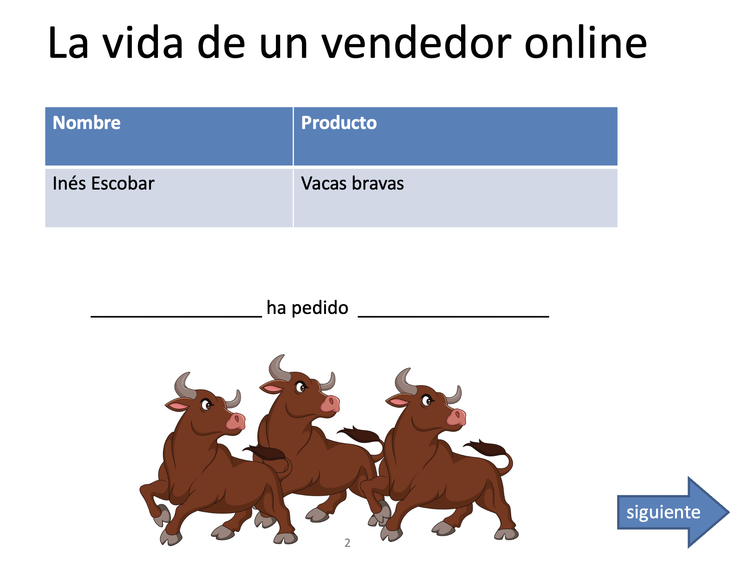
Data & Methods
Semi-Guided Picture Description Task:
152 target tokens designed to elicit singular/plural forms
Proper Name + ha pedido + una/unas + /b- d- g-/
36 speakers from Seville (WAS)
18 to 60 years (M = 21.77)
Acoustic analysis with Praat

Slide 10
Acoustic Features
Duration: How long the sound lasts
Spectral Centroid: How bright or sharp a sound is
Spectral Spread: How wide the frequencies of a sound are
Zero Crossings: How fast the sound wave vibrates
Mean HNR (Harmonics-to-Noise Ratio): How clear or noisy the sound is
Mean Intensity Ratio: How loud the sound is compared to other
Why Multiple Features?
Each feature tells a different part of the sound’s story
Expect to get a full picture of what makes one sound different from another

Slide 11
Acoustic Features
Duration: How long the sound lasts
Spectral Centroid: How bright or sharp a sound is
Spectral Spread: How wide the frequencies of a sound are
Zero Crossings: How fast the sound wave vibrates
Mean HNR (Harmonics-to-Noise Ratio): How clear or noisy the sound is
Mean Intensity Ratio: How loud the sound is compared to other
Why Multiple Features?
Each feature tells a different part of the sound’s story
Expect to get a full picture of what makes one sound different from another

Slide 12
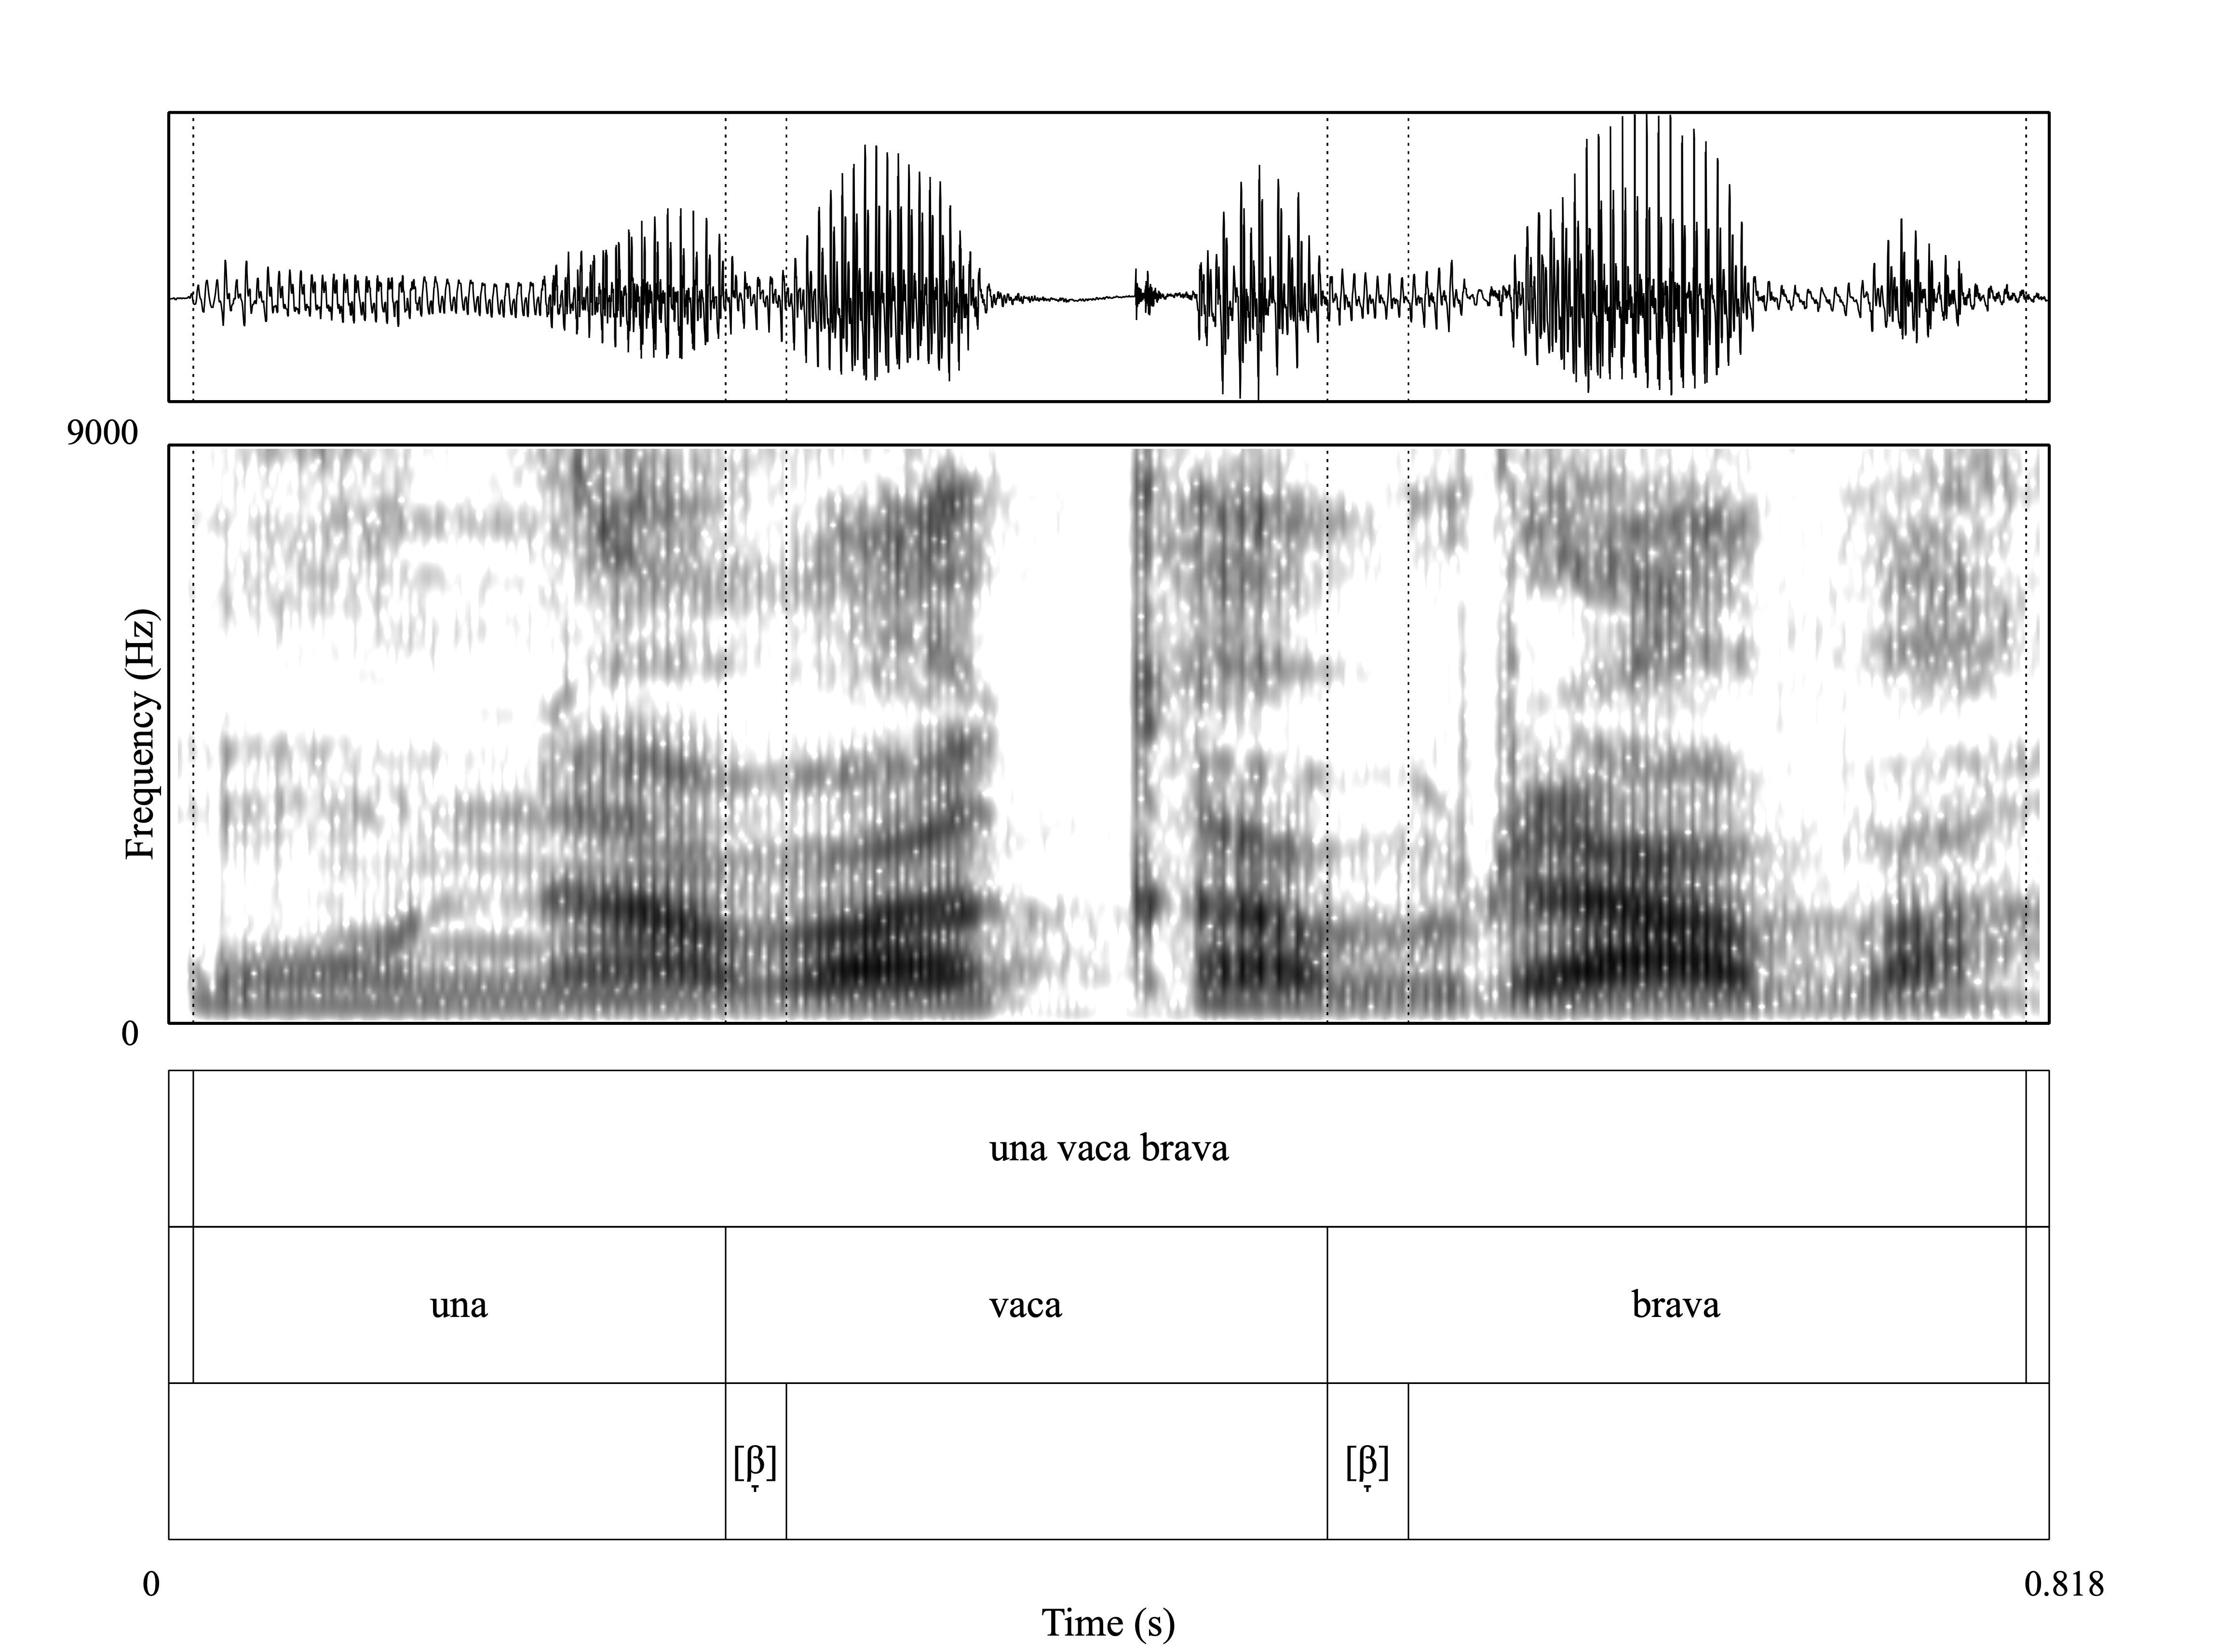
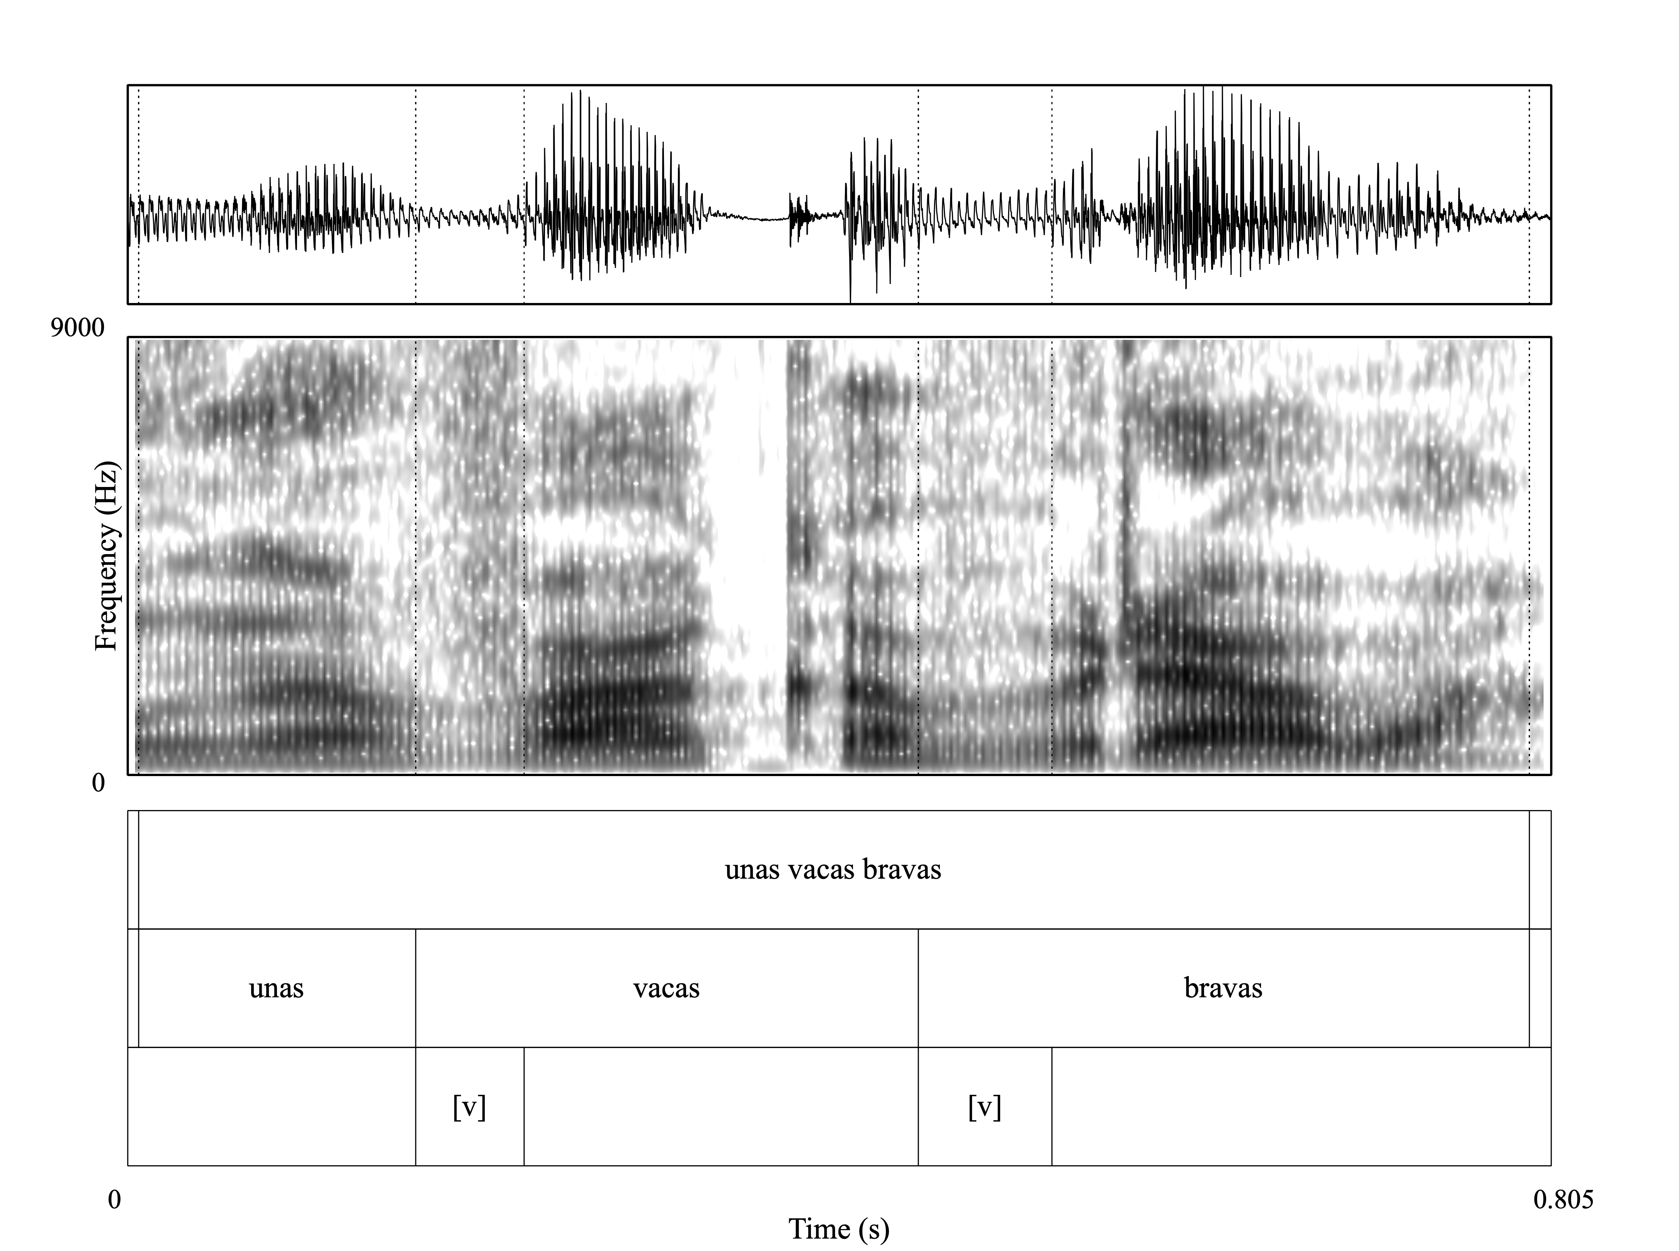
Example
26ms
35ms
62ms
76ms
Approximant Realizations
Fricative Realizations

Slide 13
Contextual Expectations
The production task was designed to trigger a particular phonological process:
Singular → Intervocalic /b d g/ (una bota) → approximant [ β̞ ð̞ ɣ̞ ]
Plural → Syllable final /-s/ + /b d g/ (unas botas) → no /s/ + fricative [ v ð ɣ ]

Slide 14
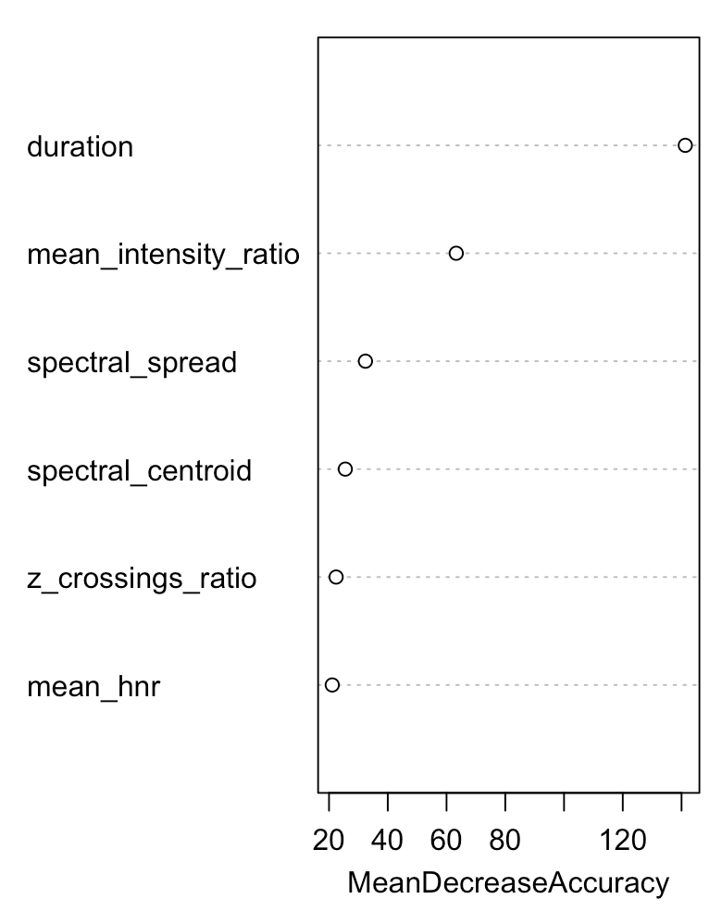
Results Which Acoustic Features Matter Most?
Multivariate Modeling: Random Forest
Importance of different acoustic features in predicting sound classification
Duration is the most important predictor
Mean Intensity Ratio and Spectral Features also play significant roles
Zero-Crossings Ratio and Mean HNR contribute less

Slide 15
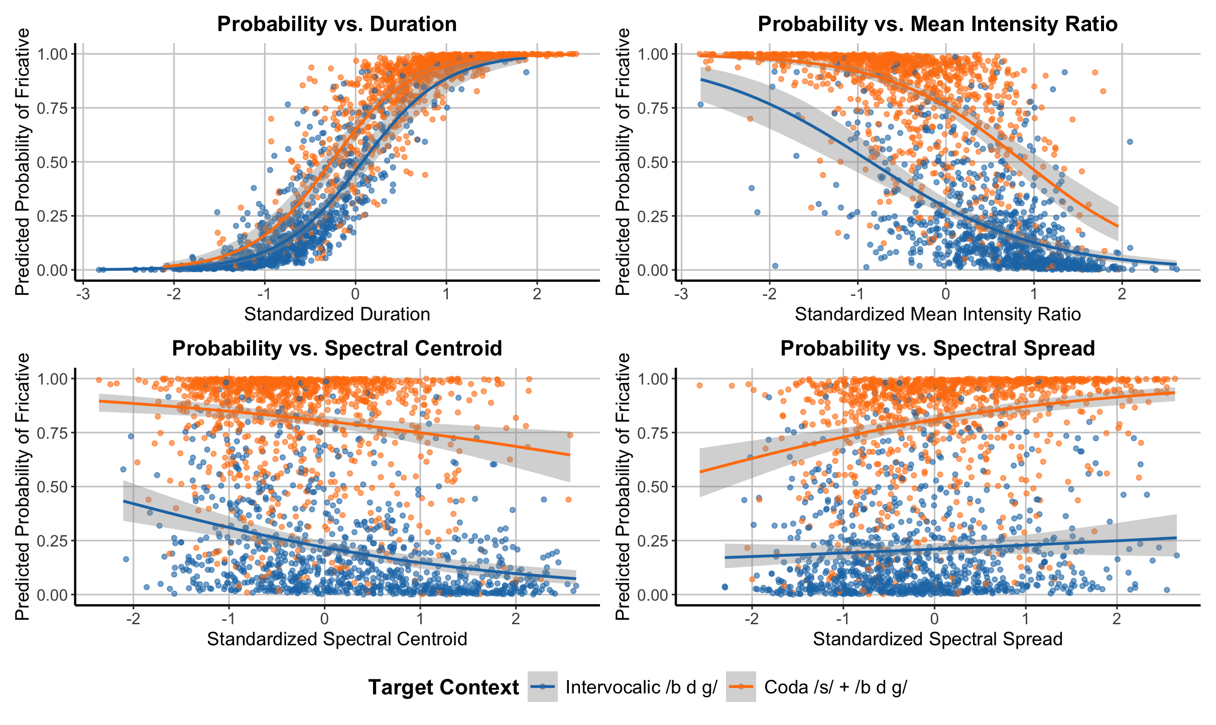
Results GLMM
Predictor | Estimate | Std. Error | p-value
Duration | 2.96 | 0.26 | < 0.001
Mean Intensity Ratio | -0.99 | 0.14 | < 0.001
Spectral Spread | -0.41 | 0.12 | < 0.001
Spectral Centroid | 0.46 | 0.14 | 0.0025
Zero-Crossing Rate | 0.10 | 0.14 | 0.47
Mean HNR | -0.11 | 0.11 | 0.32

Slide 16
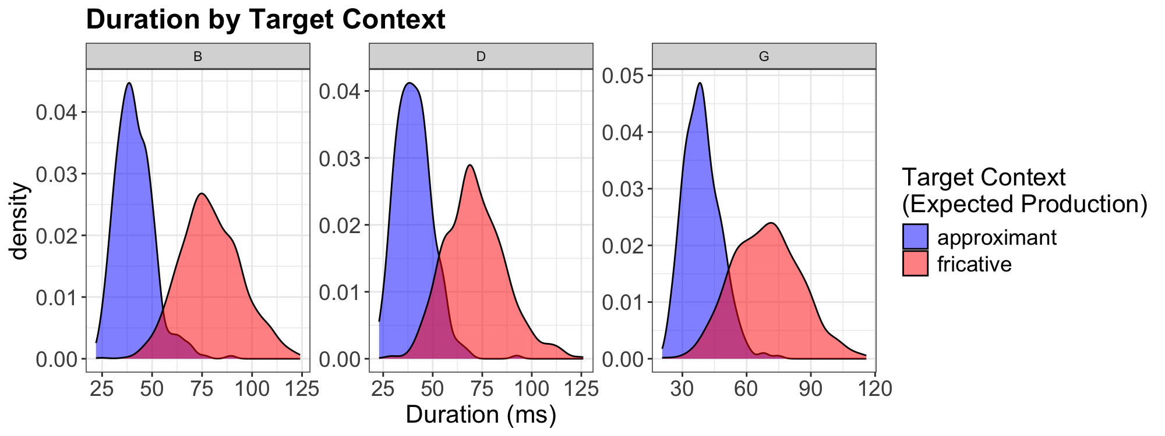
Results Acoustic Features - Duration

Slide 17
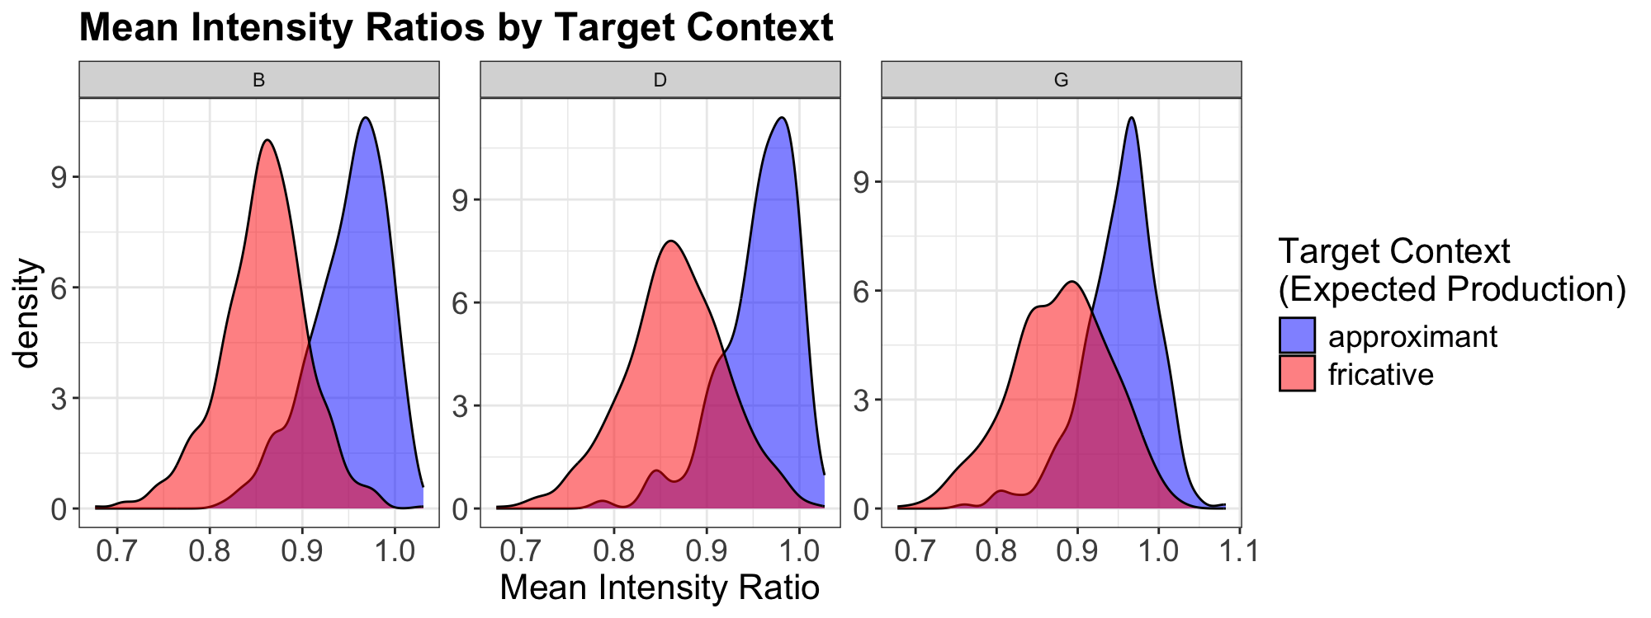
Results Acoustic Features - Intensity

Slide 18
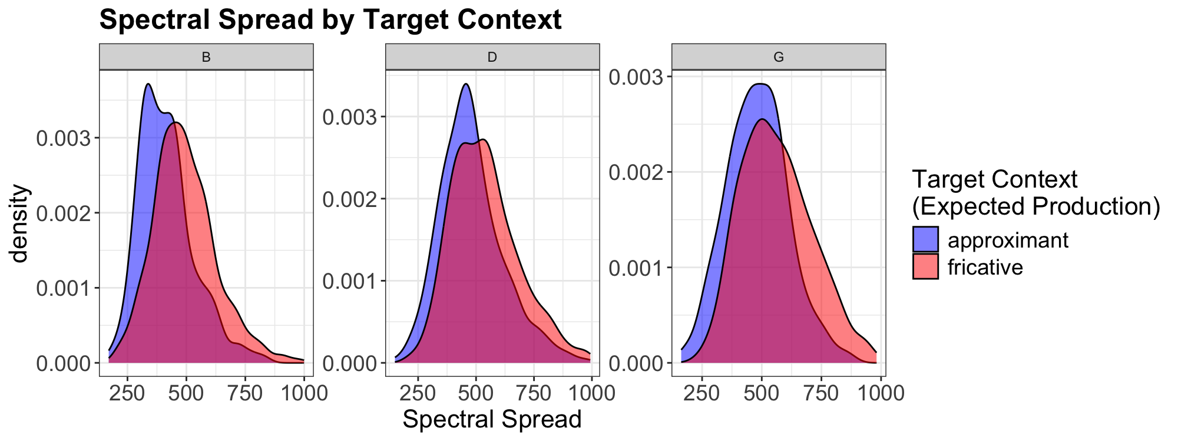
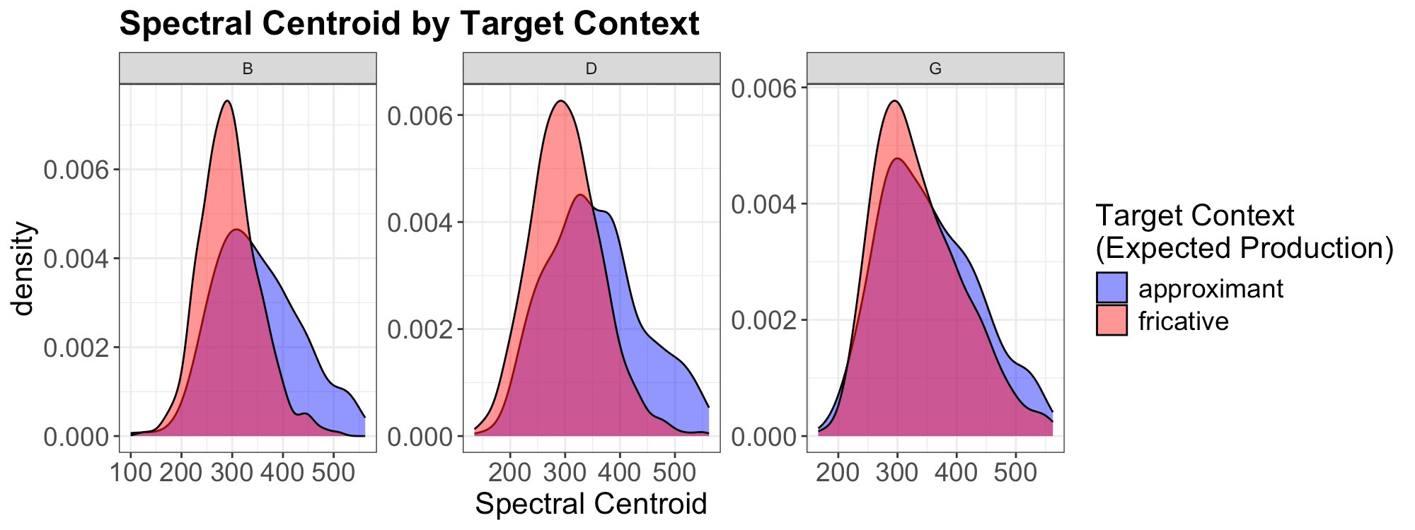
Results Acoustic Features – Spectral Features

Slide 19
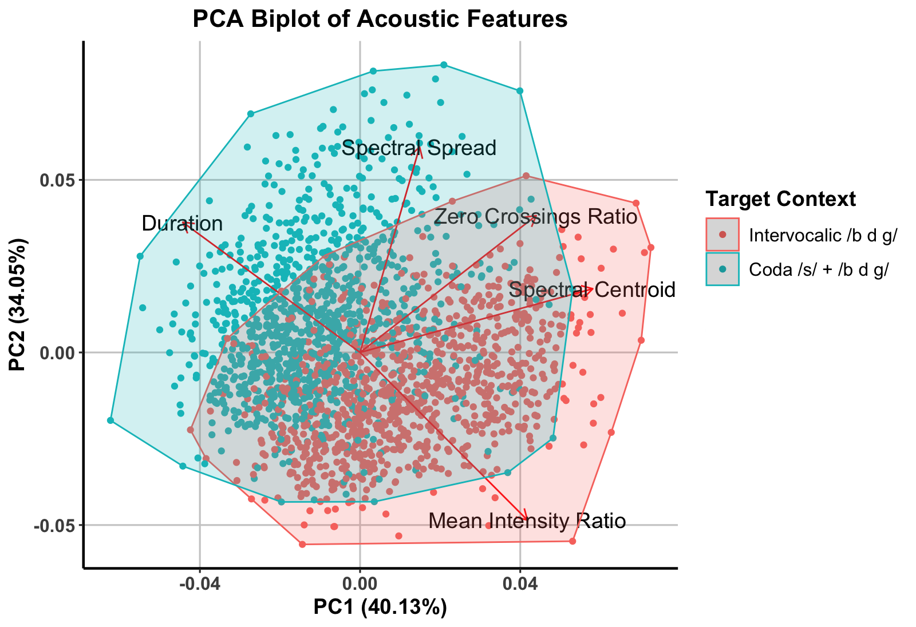
Results PCA
Notes:
Post-/s/ tokens (blue) cluster in the direction of Duration and Spectral Spread, showing systematically longer segments and greater turbulence.
Intervocalic tokens (red) align more with Intensity Ratio and Spectral Centroid, reflecting smoother, approximant-like realizations.
The overlap between groups highlights a gradient continuum, not categorical separation.

Slide 20
Interpretation
/s/ loss triggers compensatory strengthening → following /b d g/ systematically shift toward more constricted realizations
Not incidental → CVFs show a consistent acoustic pattern (longer duration, increased turbulence)
Gradient continuum → productions span from approximant-like to fricative, reflecting structured variation rather than discrete categories

Slide 21
Broader Significance
Phonetics / Phonology
CVFs show how fine phonetic adjustments (duration, turbulence) can enhance coda salience and stabilize contrast
Cross-dialectal evidence
Adds to typological cases where loss of cues triggers compensatory strengthening, aligning WAS with other leniting systems
Exemplar-based models
Demonstrates how structured gradience is not random noise, but a pathway to phonologization

Slide 22
Conclusion & Future Work
WAS CVFs emerge as a structured, compensatory response to /s/-loss, not random variation
CVFs are defined by duration + spectral turbulence, separating them from intervocalic approximants
Overlap shows variability, but distribution is structured → supports phonologization in progress
CVFs illustrate how fine-grained phonetic detail feeds into phonological adaptation and category restructuring

Slide 23

Thank you!
sarroniz@unr.edu

